Slide 1
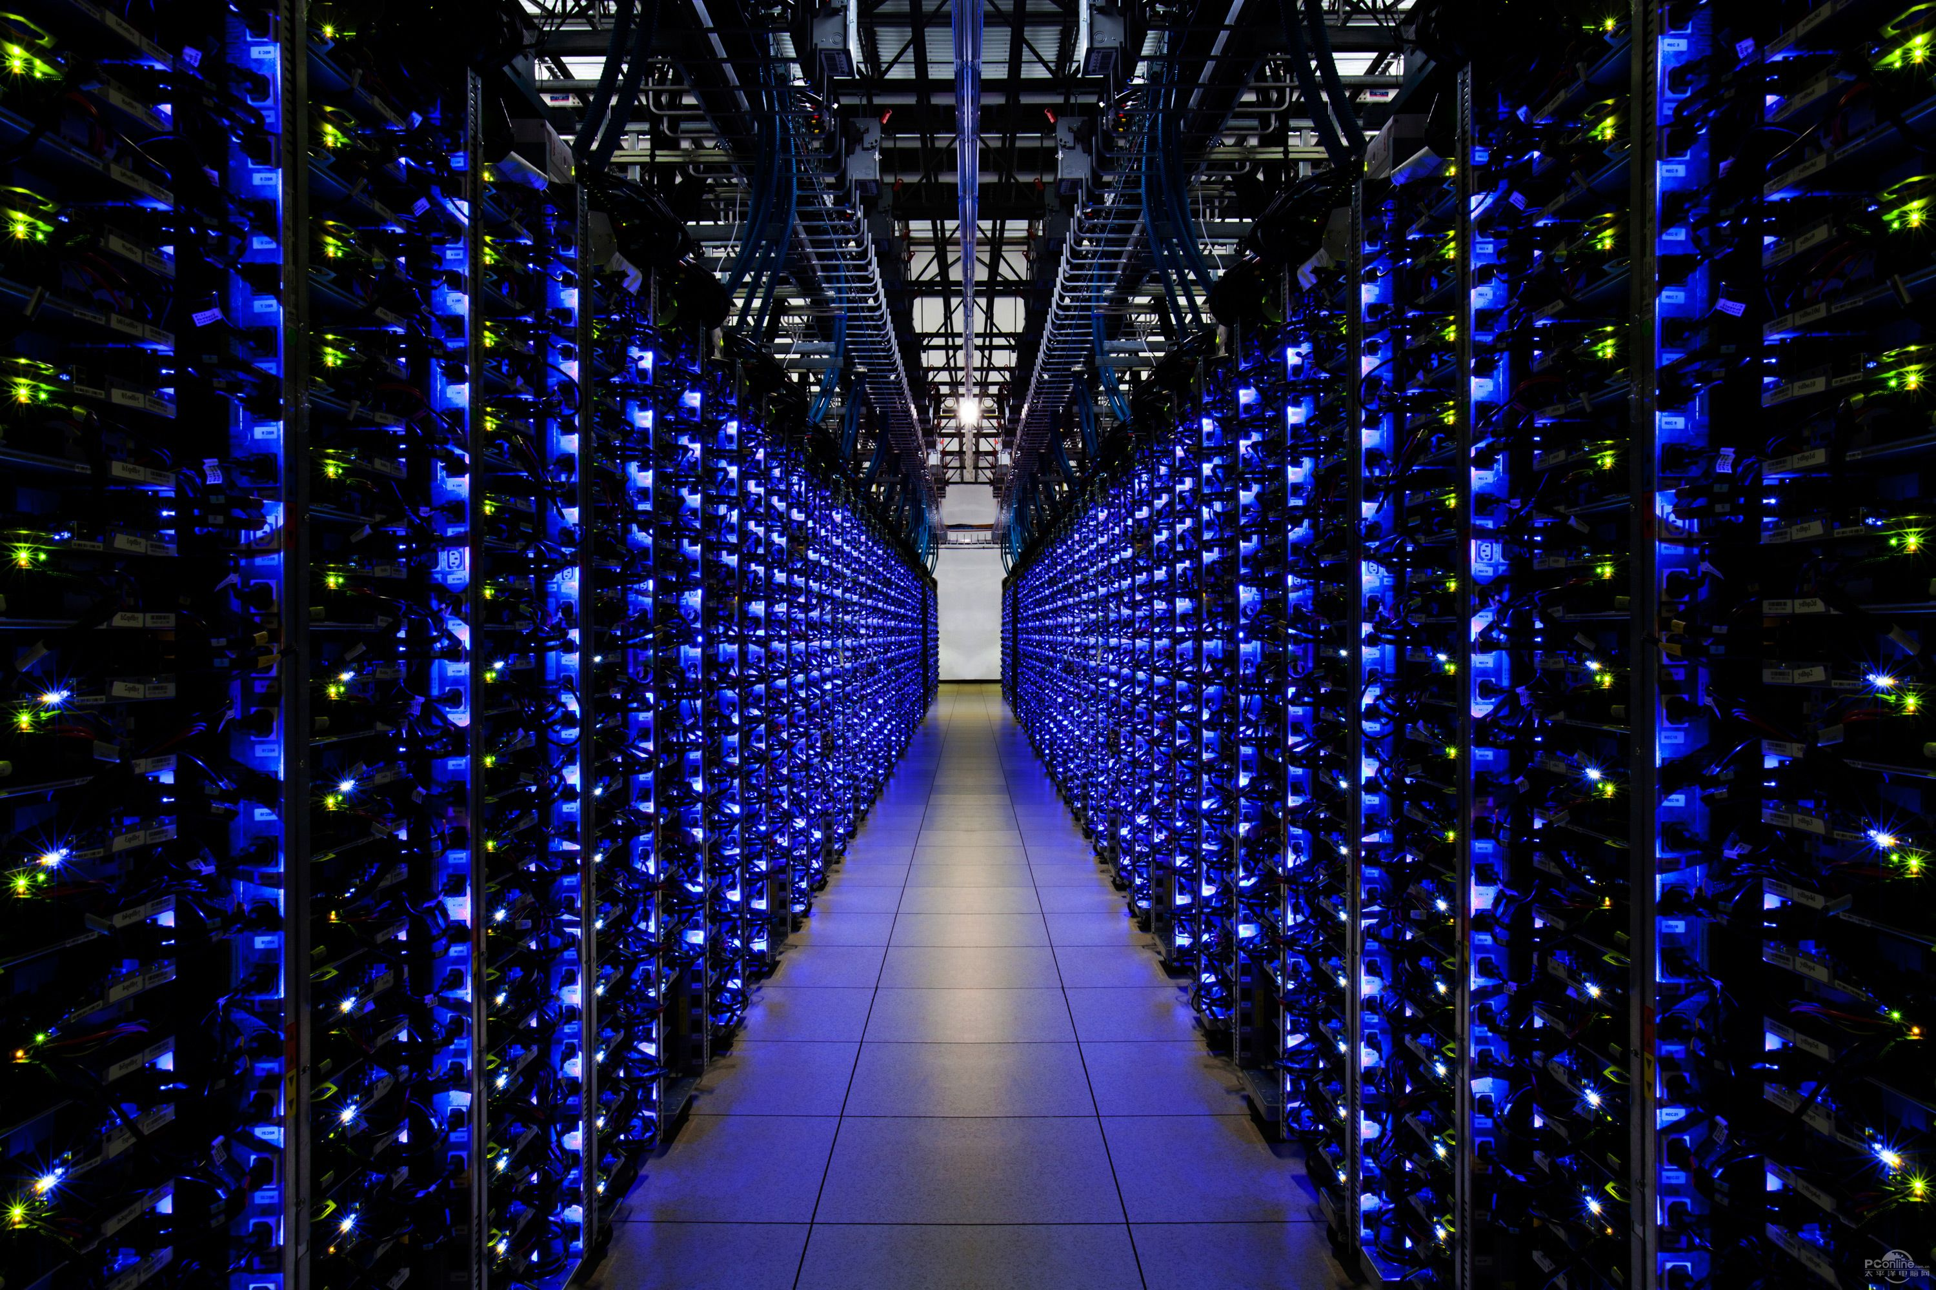
Scaling Deep Reinforcement Learning to Enable Datacenter-Scale
Automatic Traffic Optimization
Li Chen, Justinas Lingys, Kai Chen, Feng Liu (SAIC)
SING Group, HKUST

Slide 2
Scaling Deep Reinforcement Learning to Enable Datacenter-Scale
AuTO
Li Chen, Justinas Lingys, Kai Chen, Feng Liu (SAIC)
SING Group, HKUST

Slide 3
Expected Turn-around Time:
Days to Weeks
Traffic Stat Collection
DevOps Engineers:
Analysis, Design, Implementation
Traffic Optimization Policies
Notes:
Where this metaphor breaks down (as all metaphors do) is that we do not have a spine.

Slide 4
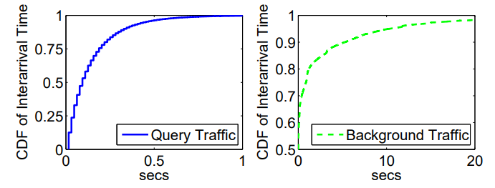
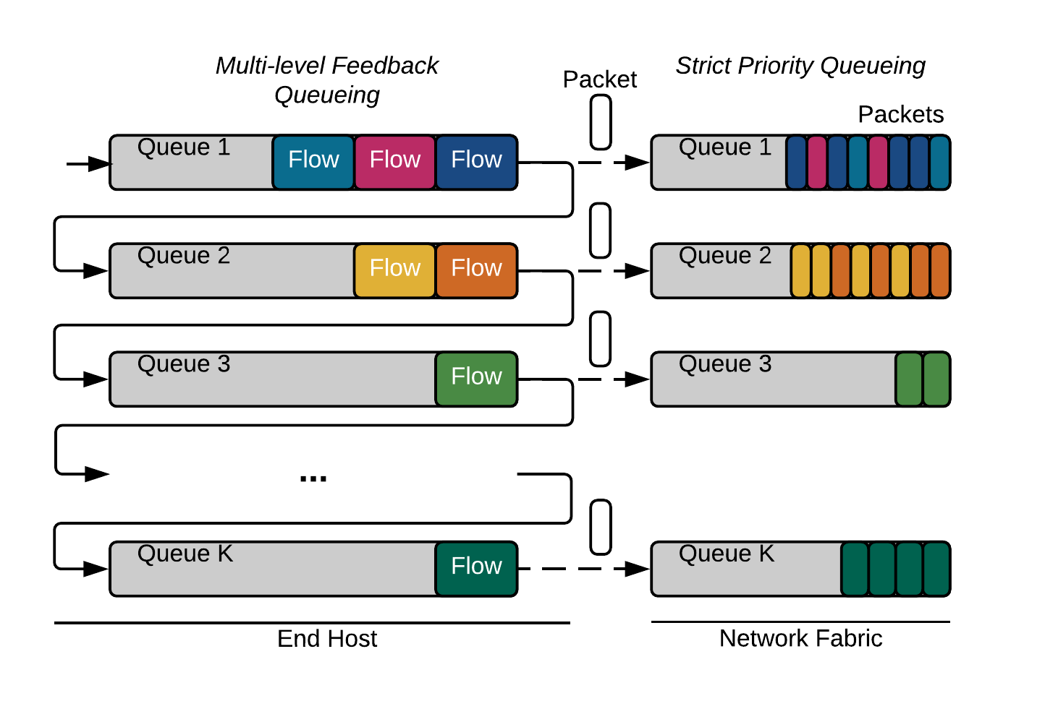
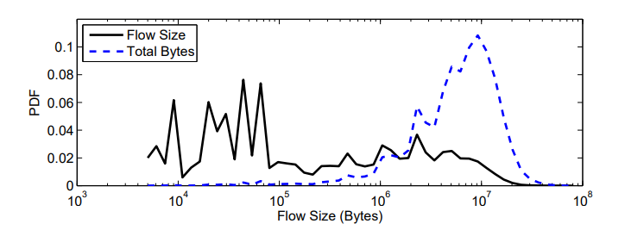
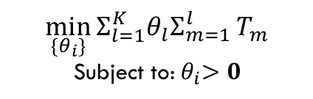
PIAS - An Example
Traffic Stat Collection
DevOps Engineers:
Analysis, Design, Implementation
Traffic Optimization Policies
Design and Impl. MLFQ
$$\min_{\{θ_{i}\}}{Σ_{l=1}^{K}θ_{l}Σ_{m=1}^{l}}T_{m}$$
Subject to:${ θ}_{i}>0$
Traffic Characteristics from large production datacenters (& papers)
Benson, Theophilus, Aditya Akella, and David A. Maltz. "Network traffic characteristics of data centers in the wild." Proceedings of the 10th ACM SIGCOMM conference on Internet measurement. ACM, 2010.
Kandula, Srikanth, et al. "The nature of data center traffic: measurements & analysis." Proceedings of the 9th ACM SIGCOMM conference on Internet measurement. ACM, 2009.
Greenberg, Albert, et al. "VL2: a scalable and flexible data center network." ACM SIGCOMM computer communication review. Vol. 39. No. 4. ACM, 2009.
Alizadeh, Mohammad, et al. "Data center tcp (dctcp)." ACM SIGCOMM computer communication review 41.4 (2011): 63-74.
Formulation & soln. for MLFQ thresholds
Turn-around Time:
~6 Months
Notes:
Where this metaphor breaks down (as all metaphors do) is that we do not have a spine.

Slide 5
PIAS - An Example
Traffic Stat Collection
DevOps Engineers:
Analysis, Design, Implementation
Traffic Optimization Policies
Data staleness
Design and Impl. MLFQ
Param.-Env. Mismatch
$$\min_{\{θ_{i}\}}{Σ_{l=1}^{K}θ_{l}Σ_{m=1}^{l}}T_{m}$$
Subject to:${ θ}_{i}>0$
Traffic Characteristics from large production datacenters (& papers)
Formulation & soln. for MLFQ thresholds
Turn-around Time:
~6 Months
Long Turn-around Time:
~6 Months
Notes:
Where this metaphor breaks down (as all metaphors do) is that we do not have a spine.

Slide 6
PIAS: An Example
DevOps Engineers:
Analysis, Design, Implementation
Traffic Optimization Policies
Expected Turn-around Time:
Days to Weeks
Traffic Stat Collection
DevOps Engineers:
High Level Directives
Expected Turn-around Time:
<1s
Artificial Intelligence
Traffic Optimization Policies
Notes:
Where this metaphor breaks down (as all metaphors do) is that we do not have a spine.

Slide 7
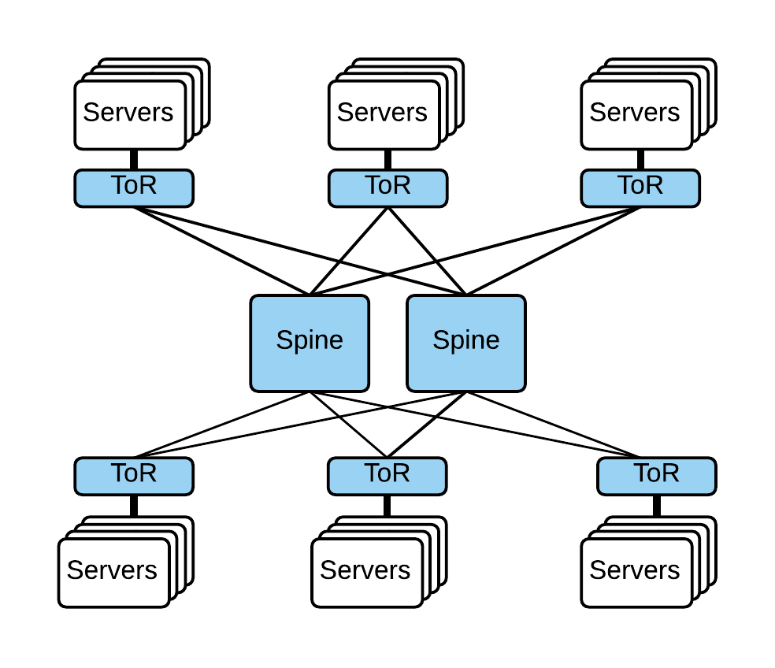
Datacenter-scale Traffic Optimizations (TO)
Dynamic control of network traffic at flow-level to achieve performance objectives.
Main goal is to minimize flow completion time.
Very large-scale online decision problem.
>10⁵ servers*
>10³ concurrent flows per second per server*
Data Center Network
Web
Big Data
Cache
DB
*Singh, Arjun, et al. "Jupiter rising: A decade of clos topologies and centralized control in google's datacenter network." ACM SIGCOMM Computer Communication Review. Vol. 45. No. 4. ACM, 2015.
*Roy, Arjun, et al. "Inside the social network's (datacenter) network." ACM SIGCOMM Computer Communication Review. Vol. 45. No. 4. ACM, 2015.
Notes:
Take a step back and look at the problem that we are trying to solve with AI.

Slide 8

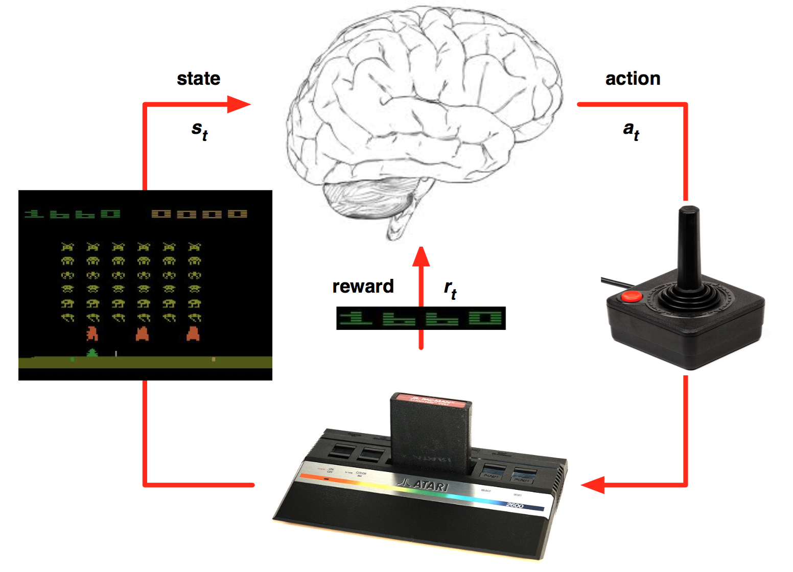

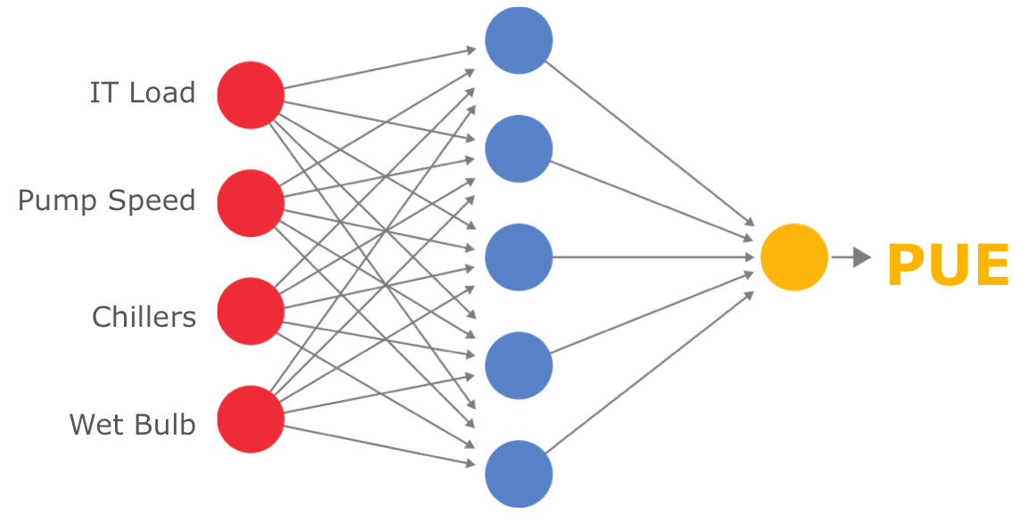
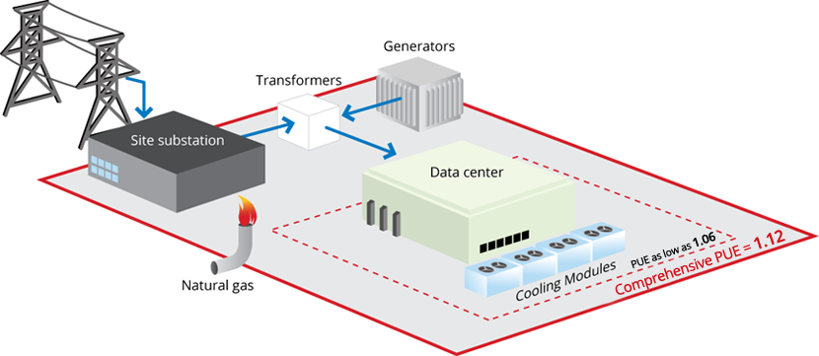
AI for the Job
Reinforcement Learning: Learning the optimal mapping from situations to actions.
Sequential decision making.
Many recent success stories of deep reinforcement learning (DRL):
AlphaGo, Google datacenter power management, Playing Atari games, …
Actions
RL Agent
Environment
State, Reward
Notes:
Google was able to reduce its total data center power consumption by 15 percent, which will save the company hundreds of millions of dollars over the next several years. Additionally, the company has already saved 40 percent alone on power consumed for cooling purposes.
http://www.theverge.com/2016/7/21/12246258/google-deepmind-ai-data-center-cooling

Slide 9
What is Deep RL?
Reinforcement Learning
Deep Learning
Conceptual framework to model control problems.
End-to-end training of expressive, multi-layer models
Deep models allow reinforcement learning algorithms to solve complex problems end-to-end!

Slide 10
End-to-end?
Deep RL can process complex input, and optimize internal representation and choice of action at the same time.
Notes:
DC-scale TO is a complex online control problem.
Can we use DRL to enable automatic DC-scale TO?
We conduct experiments to find out.

Slide 11
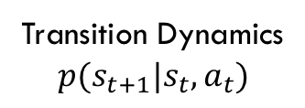
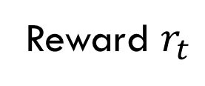
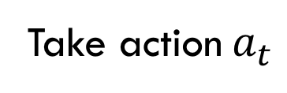
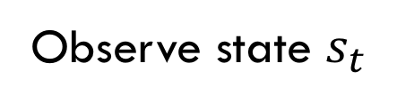
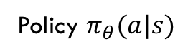
Reinforcement Learning Model
In each time step t…
Reward $r_{t}$
Agent
DCN Environment
Take action$a_{t}$
Policy $π_{θ}(a|s)$
Transition Dynamics
$$p(s_{t+1}|s_{t},a_{t})$$
Observe state $s_{t}$
Goal: maximize the expected discounted future reward $Σ_{i=t}^{T}{γ^{i−t}r}_{t}$
Notes:
[…], using Reinforcement Learning.
Let me first give you an overview of reinforcement learning
Reinforcement Learning poses a general framework, where an agent interacts with an environment. At each time step, the agent observes a state from the environment, and takes an action. As a feedback, the environment returns the agent a reward signal, indicating how good the action is. The goal of the learning agent is to maximize the total reward in the environment.
-
[…] = To overcome the issues with today's fixed ABR algorithms, we turn to design a general purposed learning algorithm. Specifically, we are proposing to learn bitrate adaptation policies, by interacting with the video streaming environment in actual network conditions

Slide 12
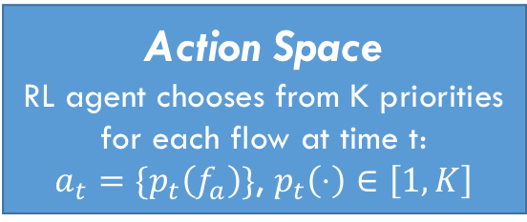
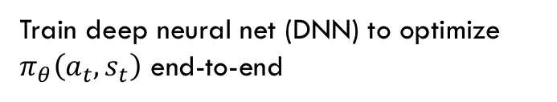
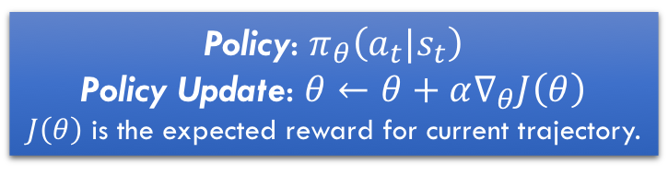
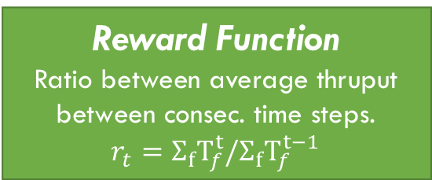
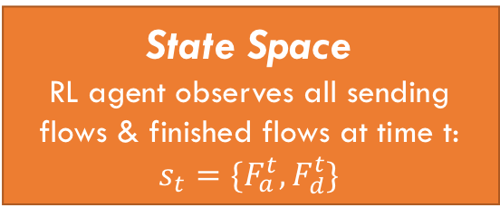
DRL Formulation for Flow Scheduling
We assume the network is running priority queuing for all flows, and well load-balanced.
Flow Scheduling → Ordering flows using priorities.
Policy gradient (PG) algorithm.
State Space
RL agent observes all sending flows & finished flows at time t:
$$s_{t}=\{F_{a}^{t},F_{d}^{t}\}$$
Reward Function
Ratio between average thruput between consec. time steps.
$$r_{t}=Σ_{f}T_{f}^{t}/Σ_{f}T_{f}^{t−1}$$
Action Space
RL agent chooses from K priorities for each flow at time t:
$a_{t}=\{p_{t}\left(f_{a}\right)\}$, $p_{t}\left(⋅\right)∈\left[1,K\right]$
Time step t
Policy: $π_{θ}\left(a_{t}|s_{t}\right)$
Policy Update: $θ←θ+α∇_{θ}J\left(θ\right)$
$J\left(θ\right)$ is the expected reward for current trajectory.
Train deep neural net (DNN) to optimize $π_{θ}\left(a_{t},s_{t}\right)$ end-to-end
In each time step t, RL agent collects the states, generates an action for each active flow, and updates the policy based on reward.

Slide 13
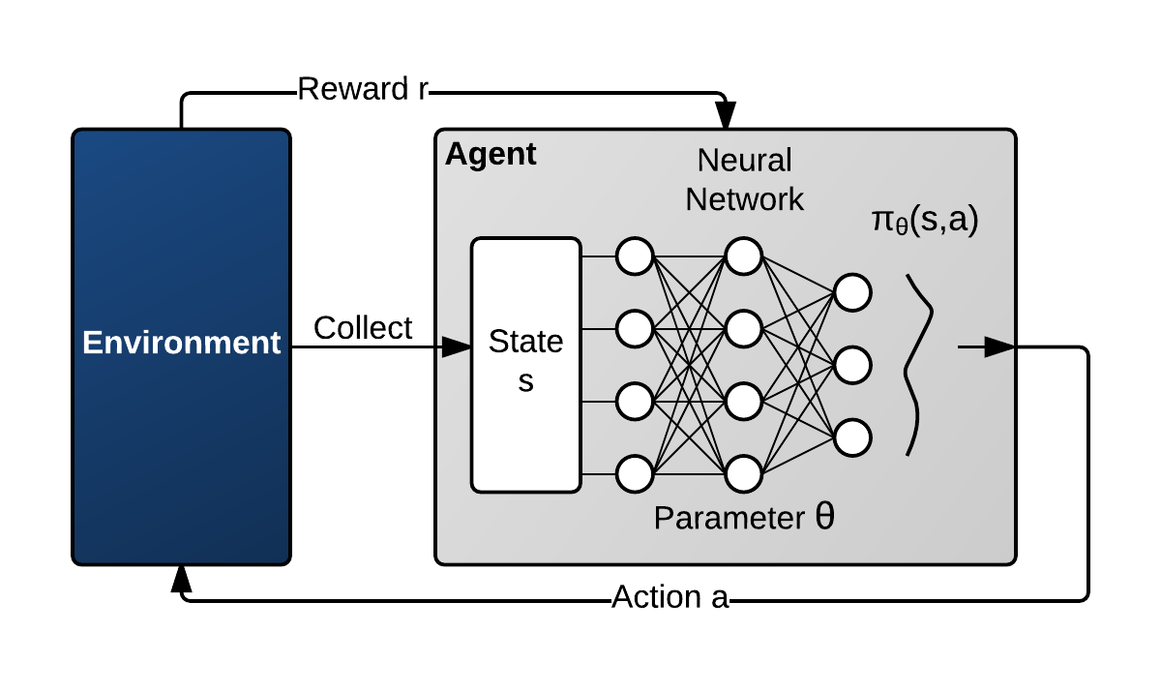
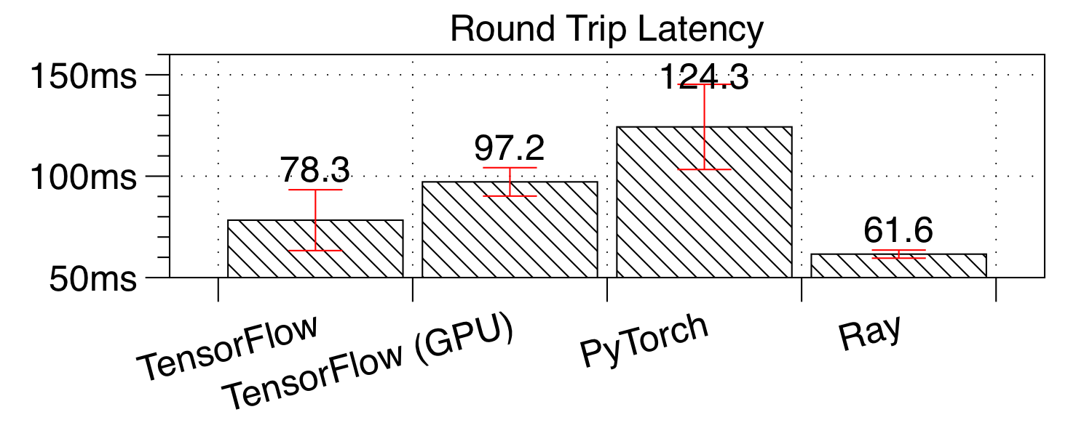
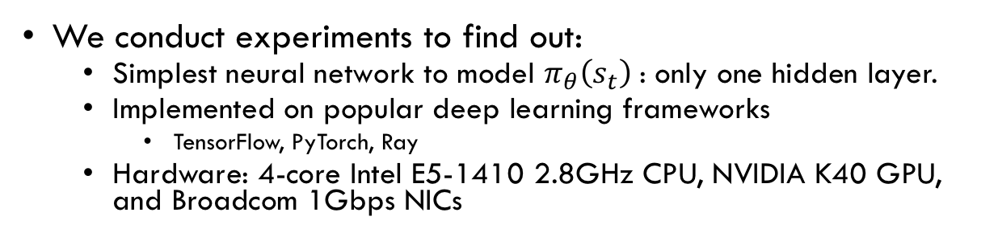
Deep RL for DC-scale TO?
We conduct experiments to find out:
Simplest neural network to model $π_{θ}\left(s_{t}\right)$: only one hidden layer.
Implemented on popular deep learning frameworks
TensorFlow, PyTorch, Ray
Hardware: 4-core Intel E5-1410 2.8GHz CPU, NVIDIA K40 GPU, and Broadcom 1Gbps NICs
For low flow arrival rate of 1000 flows-per-second, the processing delays are more than 60ms.
Any flow within 7.5MB would’ve finished on a 1Gbps link.
A 7.5MB flow is larger than 95.13% of all flows in production data centers*.
Too Slow!
Most of the DRL actions are useless: Short flows are already gone when the actions arrive.
* Alizadeh, Mohammad, et al. "Data center tcp (dctcp)." ACM SIGCOMM computer communication review. Vol. 40. No. 4. ACM, 2010.

Slide 14
How to scale DRL for datacenter-scale TO?
Exploiting well-known data center traffic characteristics*
* Alizadeh, Mohammad, et al. "Data center tcp (dctcp)." ACM SIGCOMM computer communication review. Vol. 40. No. 4. ACM, 2010.
Short flows comes and go quickly (inter-arrival time < 1s)
Long flows appear less frequently
Most flows are short flows.
Most bytes (traffic) come from long flows. Long flows are more impactful.
Key Idea: handle short flows locally at the end-hosts; process long flows centrally.

Slide 15

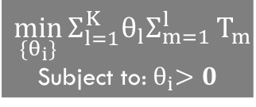
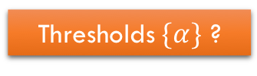
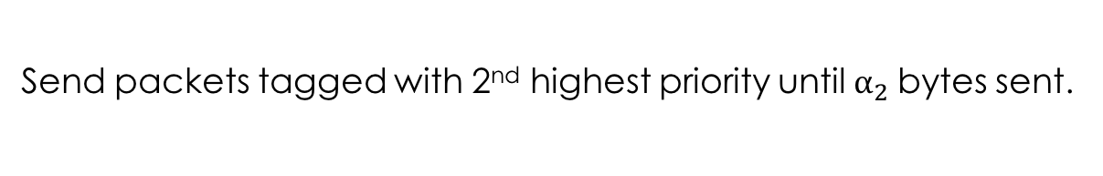
How to Sperate Short & Long Flows at End-hosts?
PIAS approximates SJF without knowing flow size
On a single link, FCT can be minimized with Shortest-Job-First (SJF)
Approx. with Multi-level feedback queue (MLFQ)
An OS process scheduling mechanism: a.k.a Foreground/Background Scheduling.
Highest Priority
2nd Highest Priority
…
Lowest Priority
Flows
Send packets tagged with the highest priority until$α_{1}$bytes sent.
Send packets tagged with 2nd highest priority until$α_{2}$bytes sent.
Thresholds$\{α\}$ ?
$$\min_{\{θ_{i}\}}{Σ_{l=1}^{K}θ_{l}Σ_{m=1}^{l}}T_{m}$$
Subject to:${ θ}_{i}>0$
Takes <1min to run solver. But it takes weeks/months to collect traffic data.
Send packets tagged with the lowest priority.
Flow-level movement on MLFQ
Notes:
HTTP chunked transfer, database query response, and many other applications generate flows without known size before the transmission.
We previously designed PIAS for flows without known sizes.
PIAS works like this, for each flow, it will first send packets tagged with the highest priority until$α_{1}$bytes sent.
Then if there's still data to be sent, its packets are tagged with the 2nd highest priority until$α_{2}$ bytes sent.
Finally, the really long flows will drop to the lowest priority, and send packets tagged with the lowest priority.
Pias mimics SJF because, for short flows, they complete quickly before they drop to a lower priority. For long flows, they naturally move to lower priorities for the majority of their bytes.
However, PIAS does not address the case where the flow sizes are known before transmission. For example, This is often true for parallel computing applications where we can extract the flow size before transmission.
// PIAS is designed for commodity data centers.

Slide 16
MLFQ at End-hosts
Multi-Level Feedback Queues
Properties
Every new flow starts at the first queue with highest priority, and is gradually demoted to lower queues after its sent bytes pass certain thresholds.
MLFQ naturally segregates short and long flows:
Short flows complete in the first few queues.
Long flows descend down to the last queue.
Threshold updating period can be long
Tolerant of DRL computation delays.

Slide 17
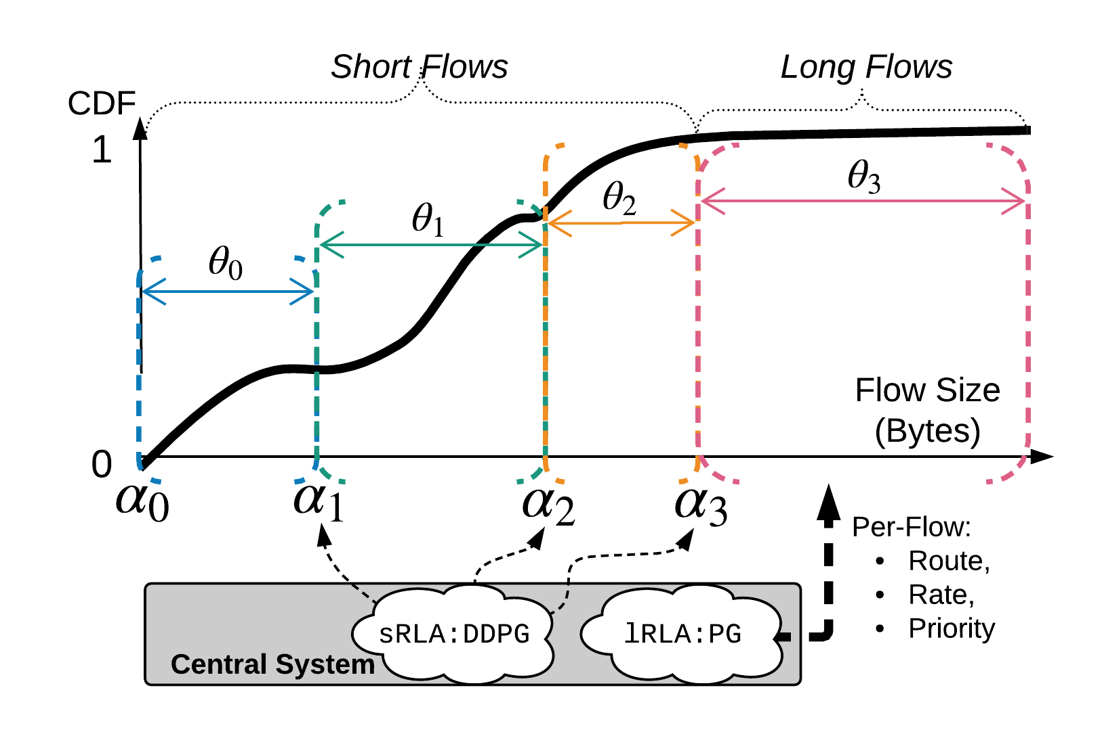
AuTO Overview
A 4-queue example.
Using MLFQ, AuTO makes per-flow decisions instantly with only local information (bytes-sent and thresholds) at end-host.
The thresholds are optimized by a DRL agent (sRLA) centrally over a relatively longer period of time.
AuTO enables end-host to make globally informed decisions on short flows with only local information (bytes-sent and thresholds).
MLFQ separates long flows from short flows.
For long flows, AuTO centrally processes them individually using a different DRL agent (lRLA) to make decisions on routing, rate limiting, and priority.
Long flows can tolerate DRL processing delays, and packet reordering due to rerouting.
Short Flow RL Agent
Long Flow RL Agent

Slide 18
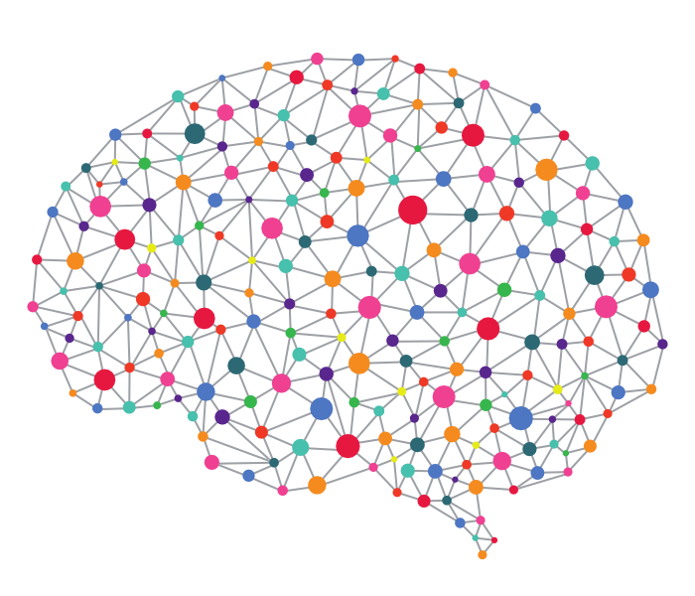
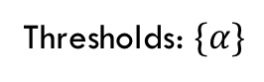
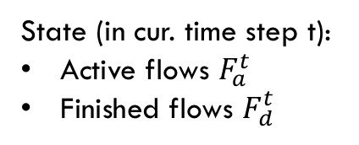
Peripheral System at End-hosts
Enforcement Module:
Runs MLFQ, Tags packets DSCP field according to its flow’s queue
Packet Tagging
Tagged packets
Network Fabric
Packets
NETFILTER
LOCAL_OUT hook
Intercepts all out-going packets.
insert_if_not_exist(flow)
byte_sent(flow)
Thresholds: $\{α\}$
Monitoring Module:
Reports flow information to Central System
Flow Table
<5-tuple, byte-sent, timing-info>
Central System
State (in cur. time step t):
Active flows $F_{a}^{t}$
Finished flows $F_{d}^{t}$

Slide 19
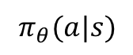
RL Agent for Long Flows (lRLA)
Actions for long flows are discrete: priority and route.
Rate-limiting does not work well due to control loop latency.
Given choices, lRLA always ends up choosing the highest rate.
AuTO relies on transport layer protocol (DCTCP) for congestion control, incast mitigation, and work conservation.
{<Priority, Route_id>}
Action a
lRLA
$$π_{θ}(a|s)$$
DCN
Environment
State s
Policy DNN generates action given state.
Policy DNN is updated with reward signals.
Policy
Reward r
Notes:
We tried several rate levels: 100Mbps, 500Mbps, 1000Mbps。

Slide 20
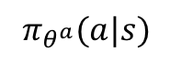
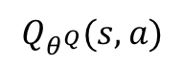
RL Agent for Short Flows (sRLA)
Optimizes thresholds for MLFQ at end-hosts.
Challenge: Thresholds are continuous.
PG algorithm cannot handle it well.
sRLA uses Deep Deterministic Policy Gradient (DDPG) to compute MLFQ thresholds.
Actor-critic algorithm
Combination of value-based methods and policy-based methods.
{Thresholds}
sRLA
Action a
$$π_{θ^{a}}(a|s)$$
Actor’s DNN generates action given state.
Actor’s DNN is updated with error signals from critic.
Actor
DCN
Environment
State s
Error
$$Q_{θ^{Q}}(s,a)$$
Action-value function
Critic’s DNN estimates Q-value: the expected cumulative reward of taking action a given state s.
Critic’s DNN is updated by minimizing estimation loss.
Critic
Reward r

Slide 21
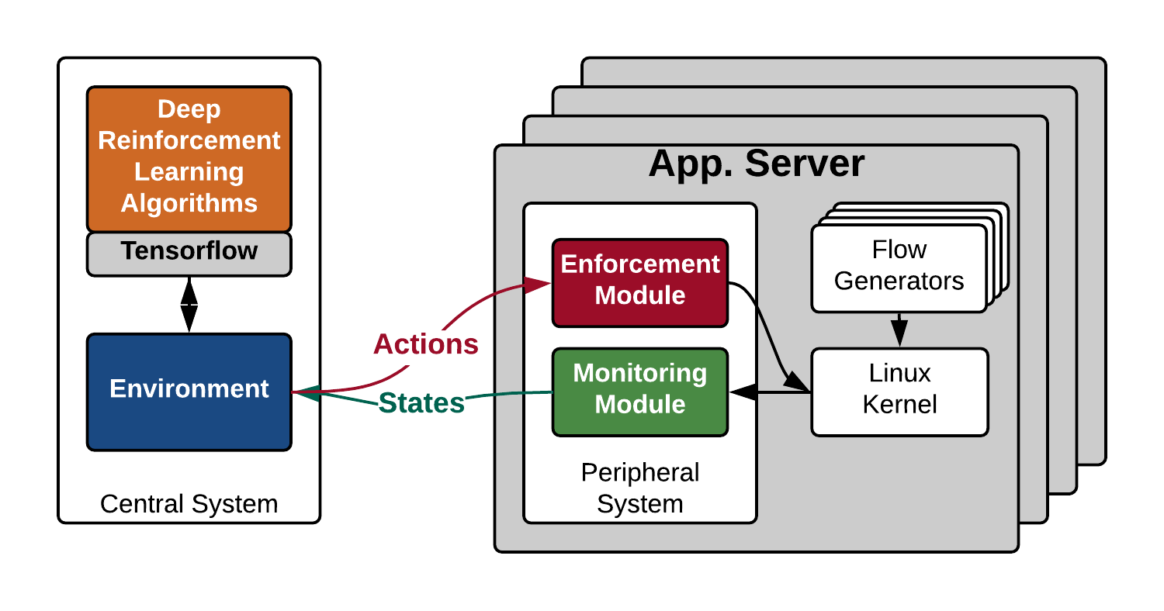


Implementation
A Python interface that abstracts “environment” and “actions” for popular deep learning frameworks.
We now support Keras, Tensorflow, and Theano.
Reusable as components in future reinforcement learning projects in datacenters.
Machine Learning experts can develop algorithms using familiar interfaces and existing scientific computing libraries.
Flow generators provide ground truth flow information, including size and completion times.
Linux TC to enforce actions.

Slide 22
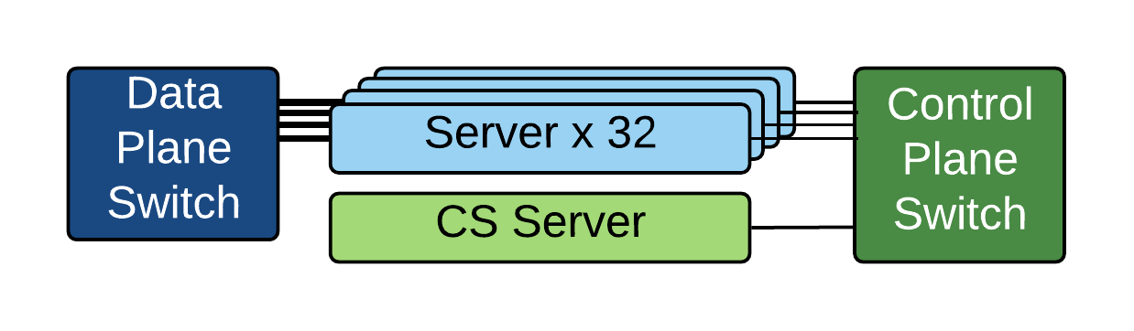
Evaluation Setting
32-server testbed
Dell PowerEdge R320
NIC with 4x 1Gbps ports
Separate control plane and data plane switch.
CS server hosts the DRL agents.
Use flow generators to produce traffic based on realistic workloads.
Web Search workload: mixture of short and long flows
Data Mining workload: mostly short flows
Comparison targets: heuristics with fixed thresholds
Quantized Shortest Job First (QSJF)
Quantized Least Attained Service (QLAS)

Slide 23
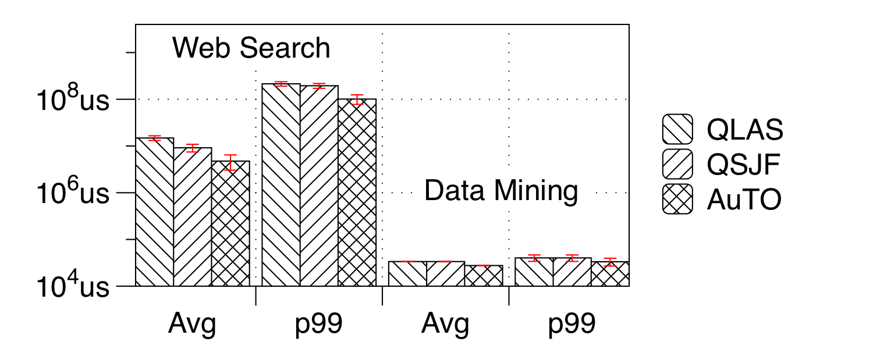
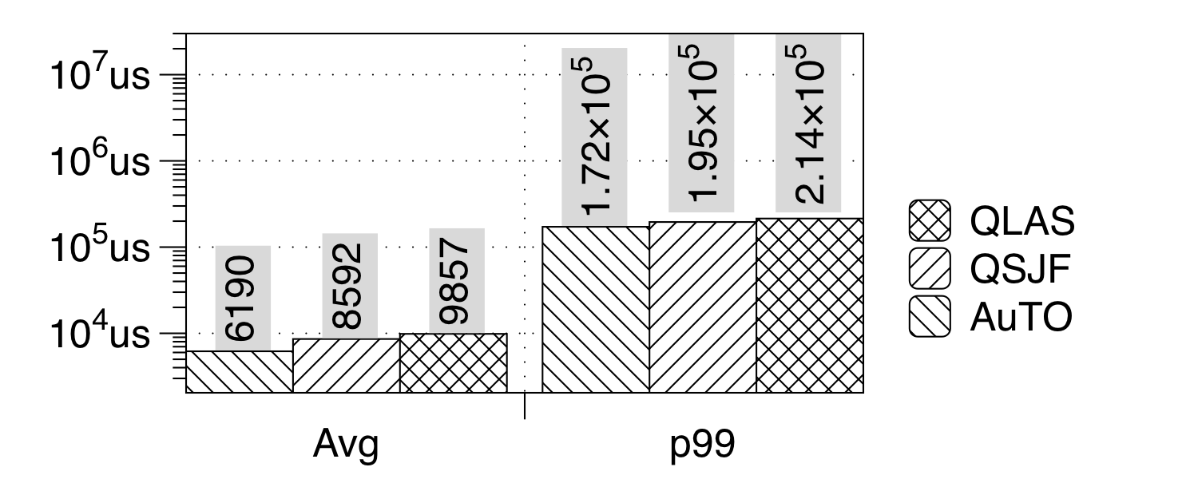
AuTO Performance
vs Heuristics with fixed parameters
Homogeneous Scenario:
Traffic distribution does not change.
Spatially Hetero. Scenario:
Traffic distribution changes for different servers.
Flow Completion Time (Lower is better)
Flow Completion Time (Lower is better)
For mixture of short and long flows (WS), AuTO outperforms the standard heuristics, achieving up to 55.93% average FCT reduction after 12 hrs of training.
For distribution with mostly short flows (DM), AuTO performs similarly compared to the heuristics.
Servers are divided into 4 groups, each with a different <work load, load percentage> combination.
Similar results compared to homogeneous scenarios.
Notes:
For mixture of short and long flows (WS), AuTO outperforms the standard heuristics, achieving up to 55.93% average FCT reduction, which is because it can dynamically change priority of long flows, thus can avoid the starvation problem in the heuristics.
For distribution with mostly short flows (DM), AuTO performs similarly compared to the heuristics, and this is because, as we show below, AuTO takes some time to generate action response to updates from server, and when the actions arrive, the flows may have already finished. Since AuTO gives any flow highest priority when it starts and change its priority only when an action is received, AuTO performs almost the same as QLAS.
This shows that AuTO, using 2 RL algorithms, can dynamically change the priorities of flows in different environments. Without any human involvement, this process can be done quickly and scalably.

Slide 24
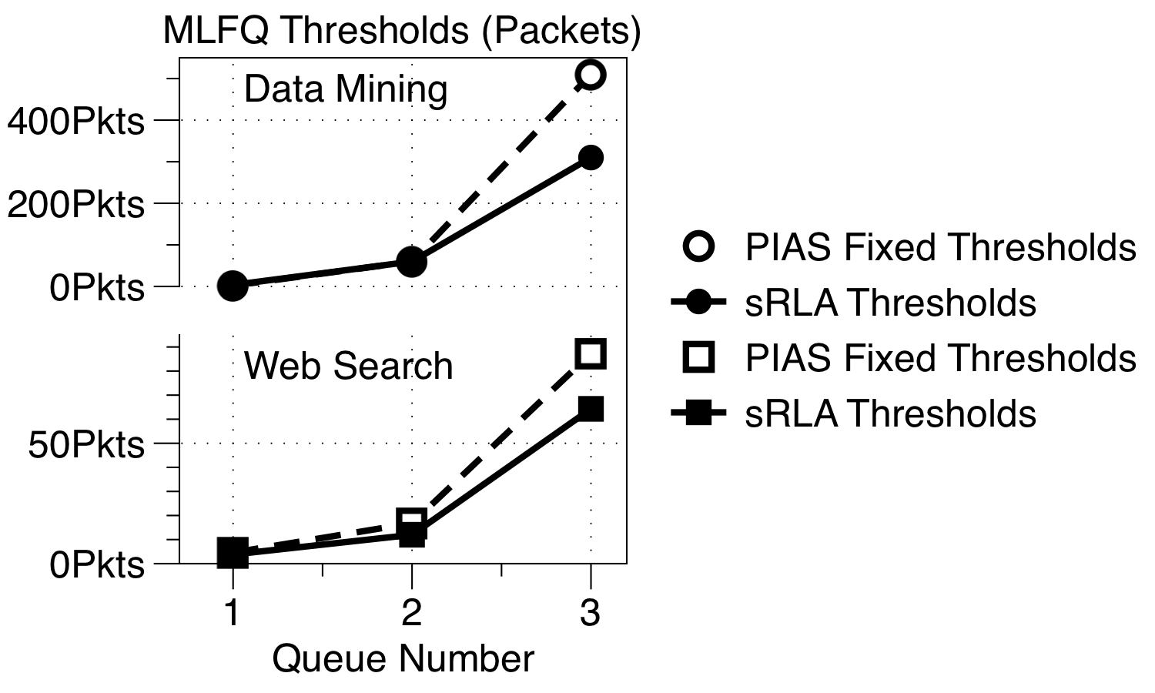
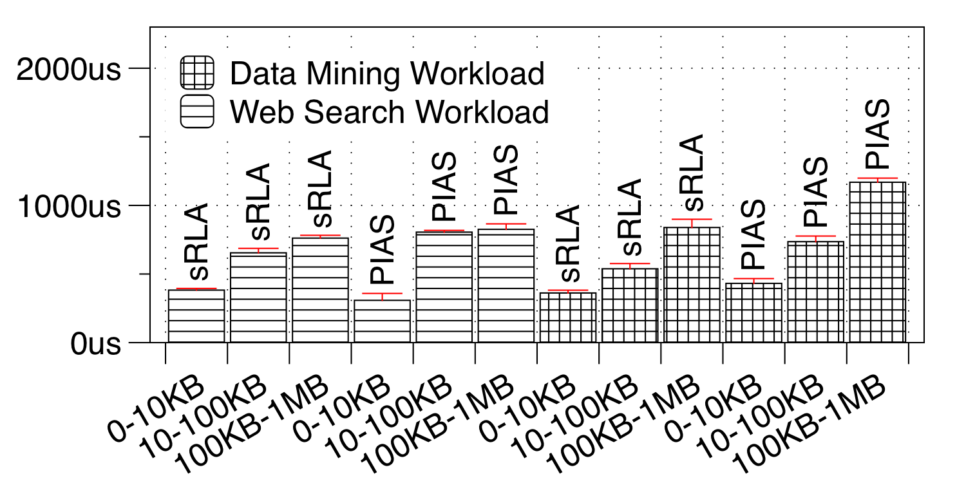
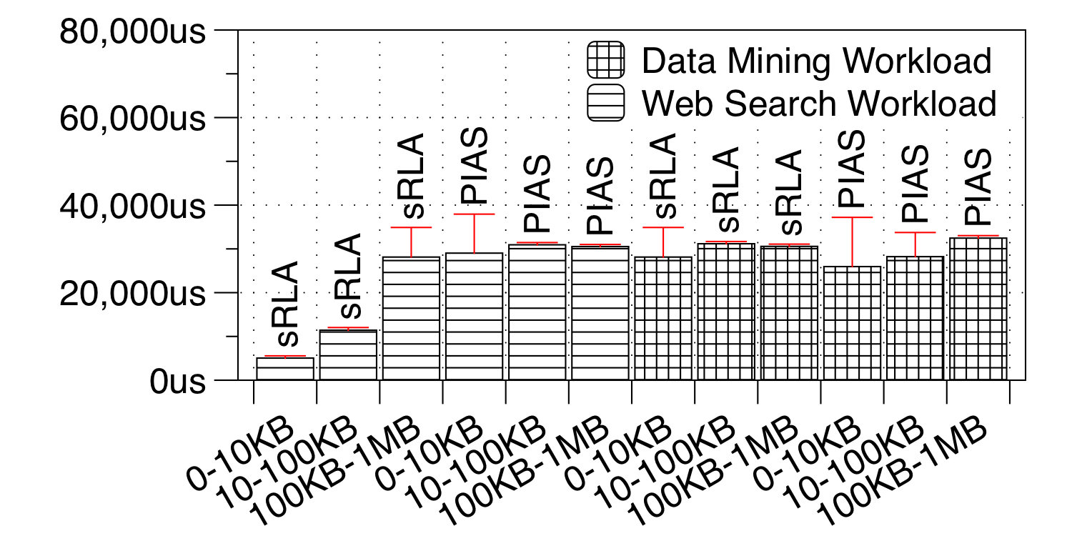
Optimizing MLFQ Thresholds with sRLA
Flow Completion Time (Lower is better)
p99 Flow Completion Time (Lower is better)
Both sets of thresholds are similar in the thresholds of the first 3 queues, and the main difference is in the last queue.
The difference in FCT is small in all groups of flow sizes.
After 8 hours of training, sRLA generated thresholds are similar to optimizer-generated ones w.r.t. performance.

Slide 25
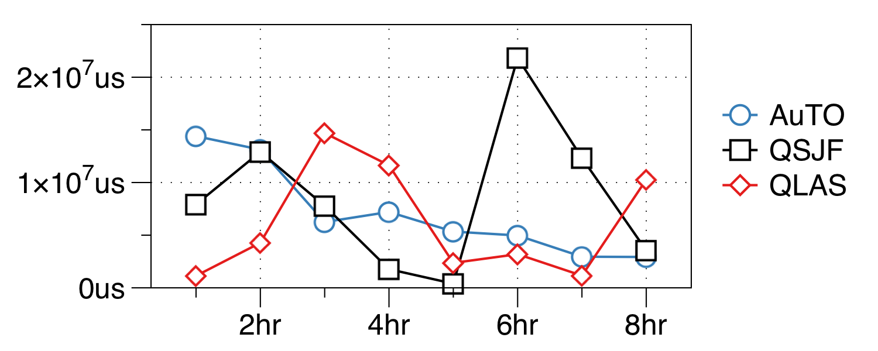
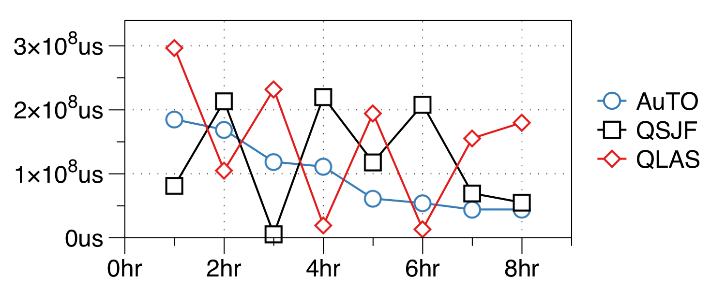
AuTO Performance
vs Heuristics with fixed parameters
Dynamic Scenario:
Traffic distribution change temporally (every hour) & spatially
Flow Completion Time (Lower is better)
p99 Flow Completion Time (Lower is better)
When parameters of heuristics mismatches the environment, their performances suffer greatly.
AuTO can learn and adapt across time-varying traffic characteristics.
In the 8th hour, AuTO achieves 8.71% reduction in average FCT vs. QSJF.
Notes:
For mixture of short and long flows (WS), AuTO outperforms the standard heuristics, achieving up to 55.93% average FCT reduction, which is because it can dynamically change priority of long flows, thus can avoid the starvation problem in the heuristics.
For distribution with mostly short flows (DM), AuTO performs similarly compared to the heuristics, and this is because, as we show below, AuTO takes some time to generate action response to updates from server, and when the actions arrive, the flows may have already finished. Since AuTO gives any flow highest priority when it starts and change its priority only when an action is received, AuTO performs almost the same as QLAS.
This shows that AuTO, using 2 RL algorithms, can dynamically change the priorities of flows in different environments. Without any human involvement, this process can be done quickly and scalably.

Slide 26
Summary
DRL has been successful in solving complex online control problems. We attempt to enable DRL for automatic traffic optimizations in data centers.
Initial experiments show that the latency of current DRL systems is the major obstacle to traffic optimizations at the scale of current datacenters.
AuTO solves this problem by exploiting long-tail distribution of datacenter traffic.
MLFQ to segregate short & long flows.
Short flows are handled at end-host locally with DRL-optimized thresholds.
Long flows are processed centrally by another DRL algorithm.
A first step towards automating datacenter traffic optimizations.

Slide 27
Q&A

Slide 28
Why Central/Peripheral System?
Inspiration from neural science
"Withdrawal Reflex". Physiology Plus. http://physiologyplus.com/withdrawal-reflex/.
When a person touches a hot object and withdraws their hand from it without actively thinking about it, the heat stimulates temperature and pain receptors in the skin, triggering a sensory impulse that travels to the central nervous system.
Animal nervous system combines central and peripheral nervous systems to handle the scalability problem. The division prevents cognitive overload.

Slide 29
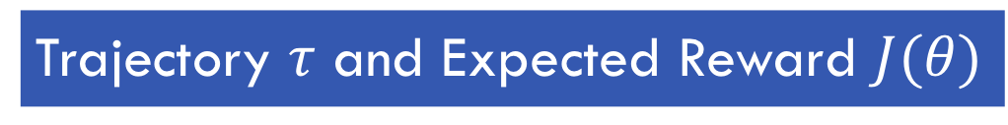
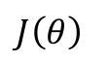
Trajectory $τ$ and Expected Reward $J(θ)$
Trajectory
$J\left(θ\right)$

Slide 30
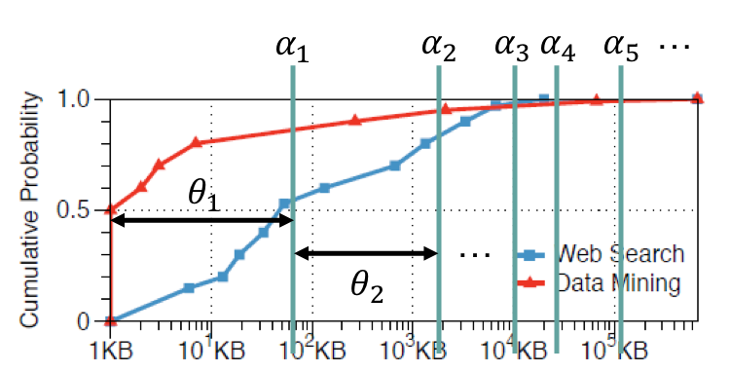
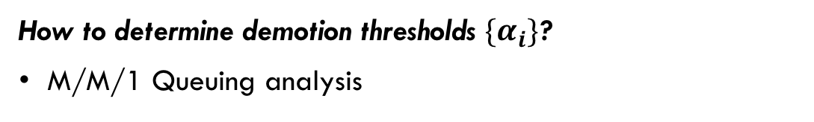
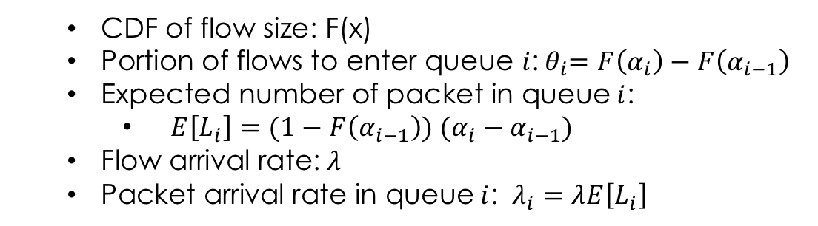
Threshold Optimization
1
How to determine demotion thresholds $\{α_{i}\}$?
M/M/1 Queuing analysis
3
2
Arrival Rate
Service Rate
Queue Delay
Flow
Pkts to send on Queue 1
Pkts on Queue 2
…
CDF of flow size: F(x)
Portion of flows to enter queue $i$:${ θ}_{i}=F\left(α_{i}\right)−F\left(α_{i−1}\right)$
Expected number of packet in queue$i$:
$E\left[L_{i}\right]=(1−F\left(α_{i−1}\right)) (α_{i}−α_{i−1})$
Flow arrival rate:$λ$
Packet arrival rate in queue$i$: $λ_{i}=λE\left[L_{i}\right]$

Slide 31
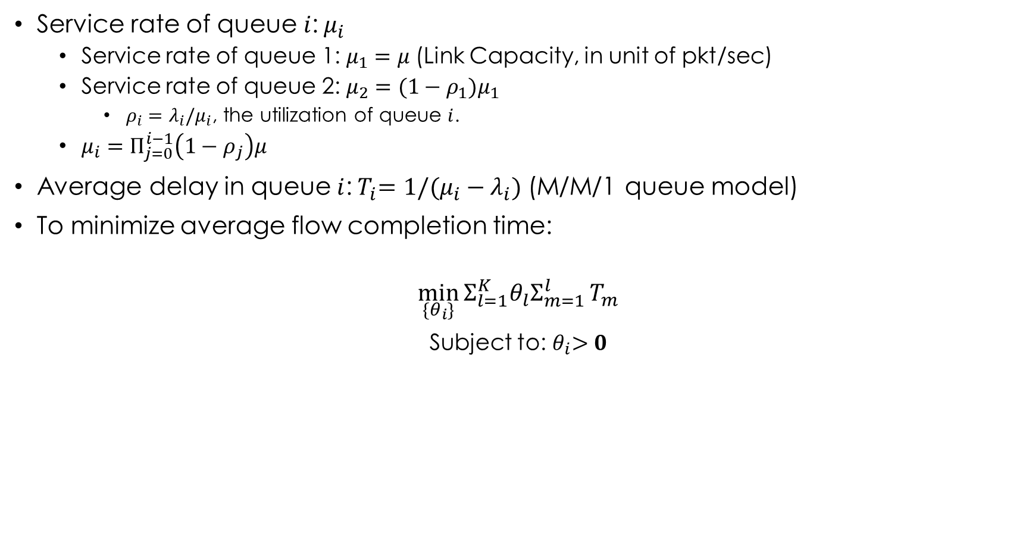
Threshold Optimization, Cont.
1
Service rate of queue$i$:$μ_{i}$
Service rate of queue 1:$μ_{1}=μ$ (Link Capacity, in unit of pkt/sec)
Service rate of queue 2:$μ_{2}={(1−ρ_{1})μ}_{1}$
$ρ_{i}=λ_{i}/μ_{i}$, the utilization of queue $i$.
$μ_{i}=Π_{j=0}^{i−1}\left(1−ρ_{j}\right)μ$
Average delay in queue$i$:${ T}_{i}=1/(μ_{i}−λ_{i})$ (M/M/1 queue model)
To minimize average flow completion time:
$$\min_{\{θ_{i}\}}{Σ_{l=1}^{K}θ_{l}Σ_{m=1}^{l}}T_{m}$$
Subject to:${ θ}_{i}>0$
3
2
Flow
FCT ← Summation of time spent in each queue.
Pkts to send on Queue 1
Pkts on Queue 2
…
Number of variables is small ($K< 8$), the optimization problem can be solved numerically and quickly with existing solvers.

